Slide 1
Lecture 1 Introduction
Spring 2024
Zhihua Jiang

Slide 2
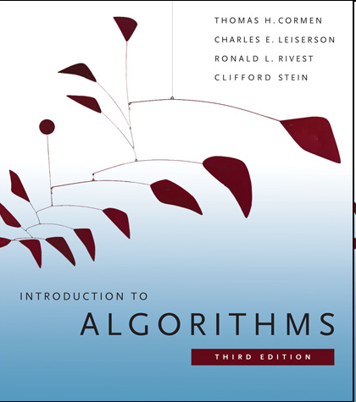
Textbook & Grade
Thomas Cormen, Charles Leiserson, Ronald Rivest, and Clifford Stein. Introduction to Algorithms. 3rd ed. MIT Press, 2009. (CLRS book)
Grade system: in-class test (per month) + final exam
Class group: 885165289 (QQ)
TIPS:
The book’s online resources (lectures, projects, assignments, etc.) are publicly available;
To implement algorithms, Python/C++/Java are commonly used;
Reference books + teacher’s lectures, a recommended way to learn this course.

Slide 3
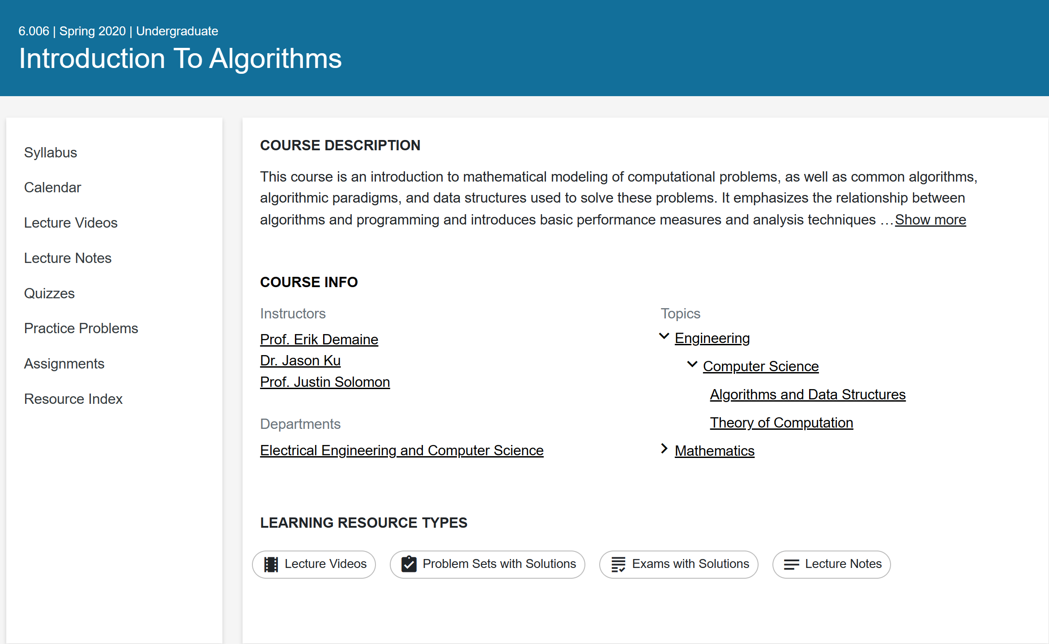
Resources
MIT 6.006 2020
https://ocw.mit.edu/courses/6-006-introduction-to-algorithms-spring-2020/

Slide 4
MIT Algorithm courses
Introduction to Algorithms (6.006)
Design and Analysis of Algorithms (6.046J)
Advanced Algorithms (6.854J)
Notes:
Trilogy[ˈtrɪlədʒi]

Slide 5
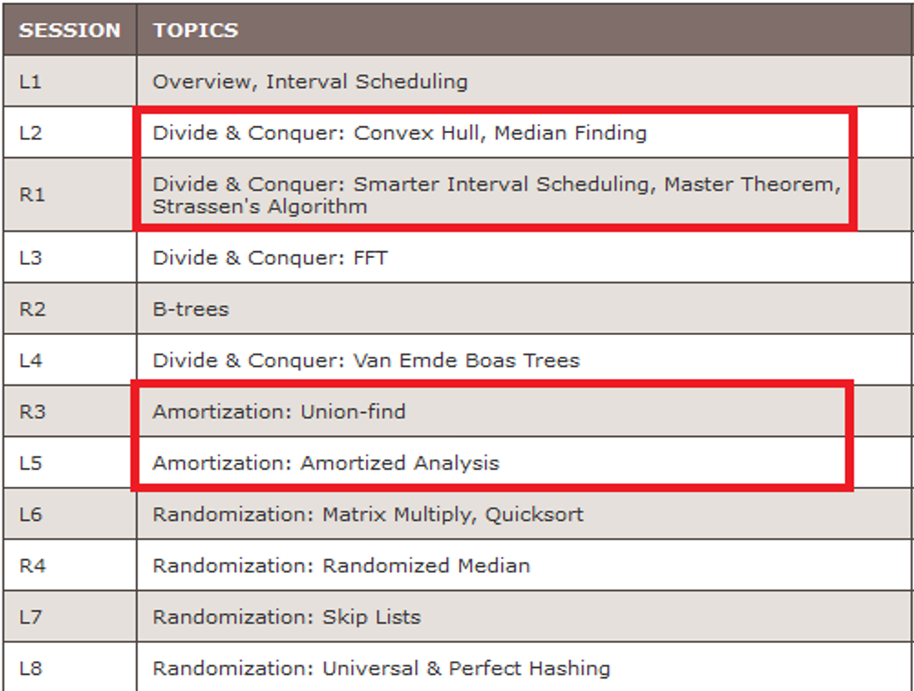
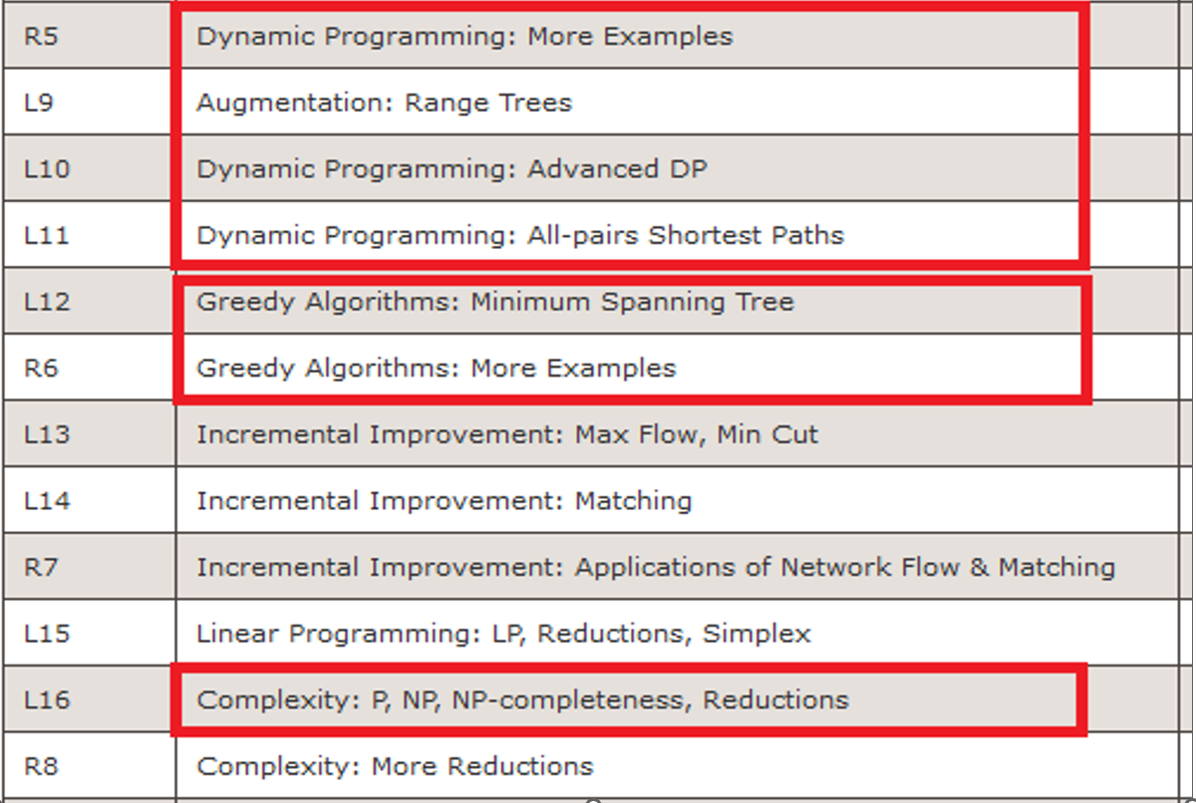
Design and Analysis of Algorithms

Slide 6
Content in this course
Introduction
Divide and conquer
Computation models
Sorting and trees
Dynamic programming
Greedy algorithm
NP completeness

Slide 7
Definition of algorithms
A sequence of steps which is used to solve a category of problems.
Unambiguous: every step is deterministic;
Mechanical: machine can “understand”;
Finite: can be implemented in limited steps;
Input/output: to state the problem size and the result.

Slide 8
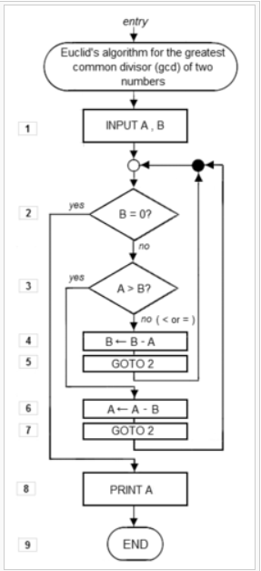
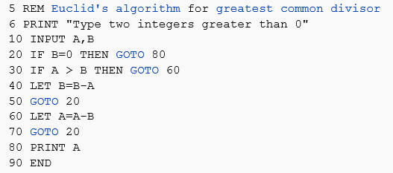
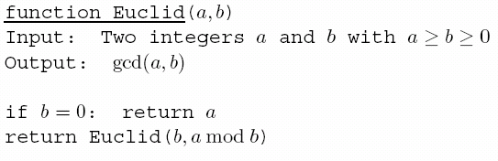
Algorithm representation
Program
√ Pseudocode
Flow chart

Slide 9
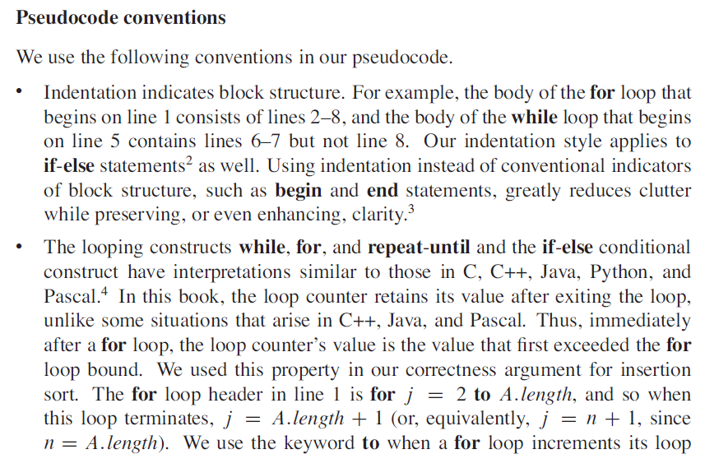

Slide 10
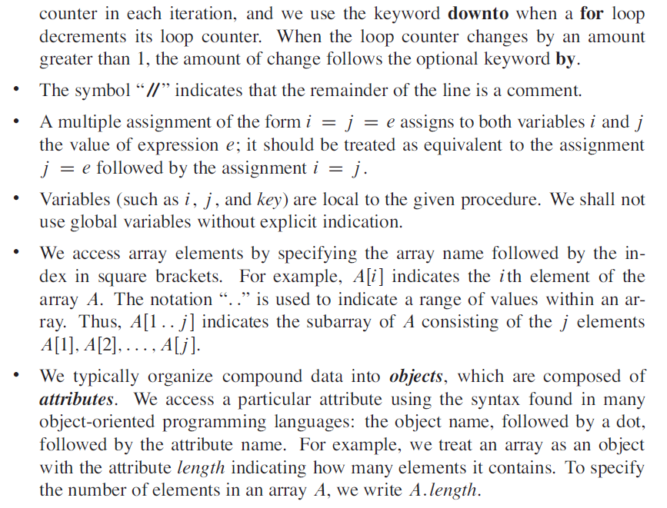
Notes:
comment[ˈkɑːment]
// backslash

Slide 11
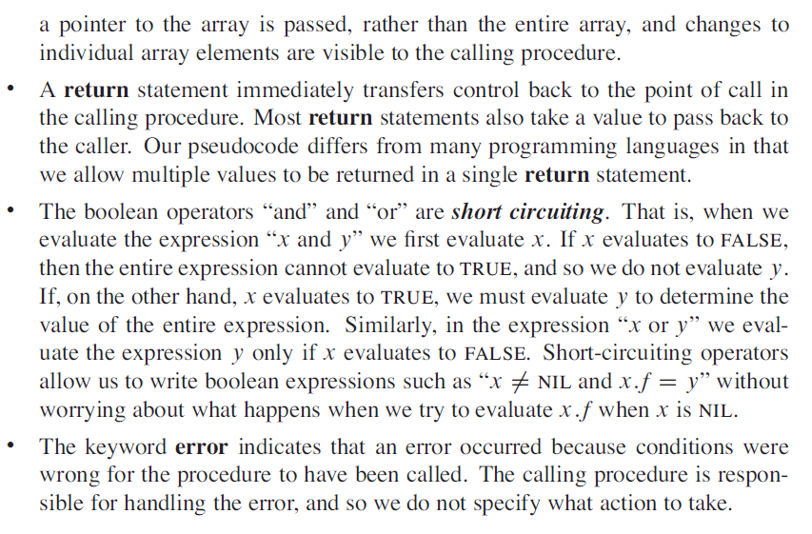

Slide 12
Algorithm vs. Program
Some people maybe think that algorithms are just programs. We need to clarity that programs could be a way to express algorithms, and they are not exactly same.
The big difference between algorithms and programs is that algorithms are for people to communicate while programs are for machines to run.
Generally, algorithms cannot be directly executed in computers. In additions, it is too precise when we use programs to express algorithms.

Slide 13
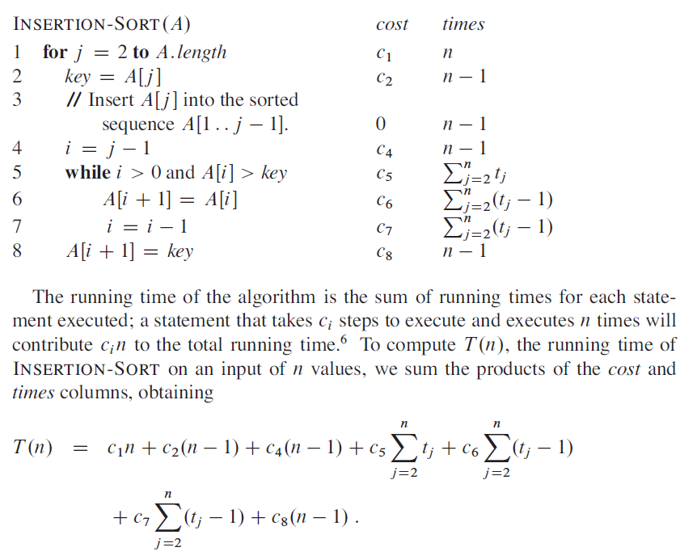
Example of T(n)
t_{j}: the number of comparisons in the while loop to insert the jth element
Ex: 4 2 8 3
j=2 key=2, t2=2
j=3 key=8, t3=1
j=4 key=3, t4=3
Notes:
(n+1)-2+1=n

Slide 14
Asymptotic notation
Why not express running time in terms of basic computer steps?
Too precise: you need to count the times carefully.
Depend on particular machines: the cost could be different.
Simplification: 5n³+4n+3 → 5n³ → n³
Leave out lower-order terms (insignificant as n grows)
Leave out the coefficient in the leading term (computers will be faster)
Finally, 5n³+4n+3 = O(n³)

Slide 15
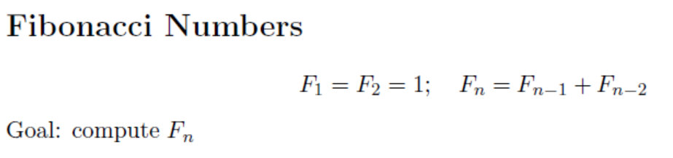
Why analysis?
Correctness
Is the algorithm correct?
Efficiency
Can we do better?
Example

Slide 16
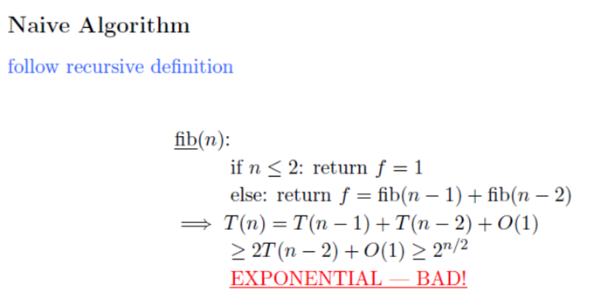

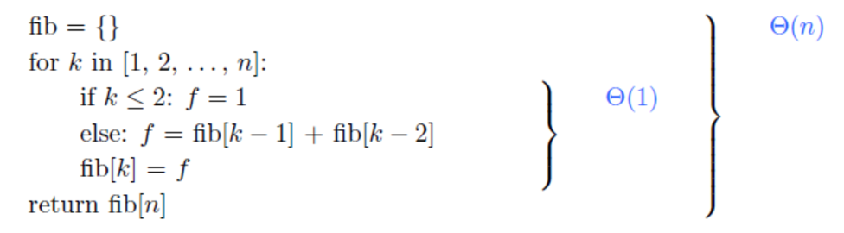

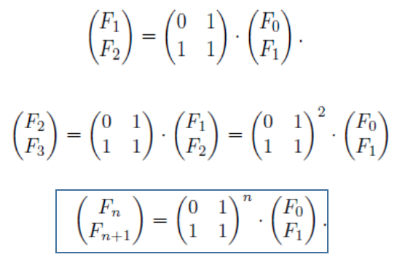

Slide 17


O notation
Definition:
n: size of problem
f =O(g) is a loose analog of “f ≤g”. It differs from the usual notion ≤ because of the constant c.
E.g., 2n+20 =O(n²), 2n+20 =O(n+1), n+1 =O(2n+20), but n² ≠O(2n+20)

Slide 18
2n+20 =O(n²): for n ≤ 5, n² is smaller; n > 5, n² is larger.
But, 2n+20 scales much better than n² as n grows. (i.e., 2n+20 grows no faster than n²)

Slide 19
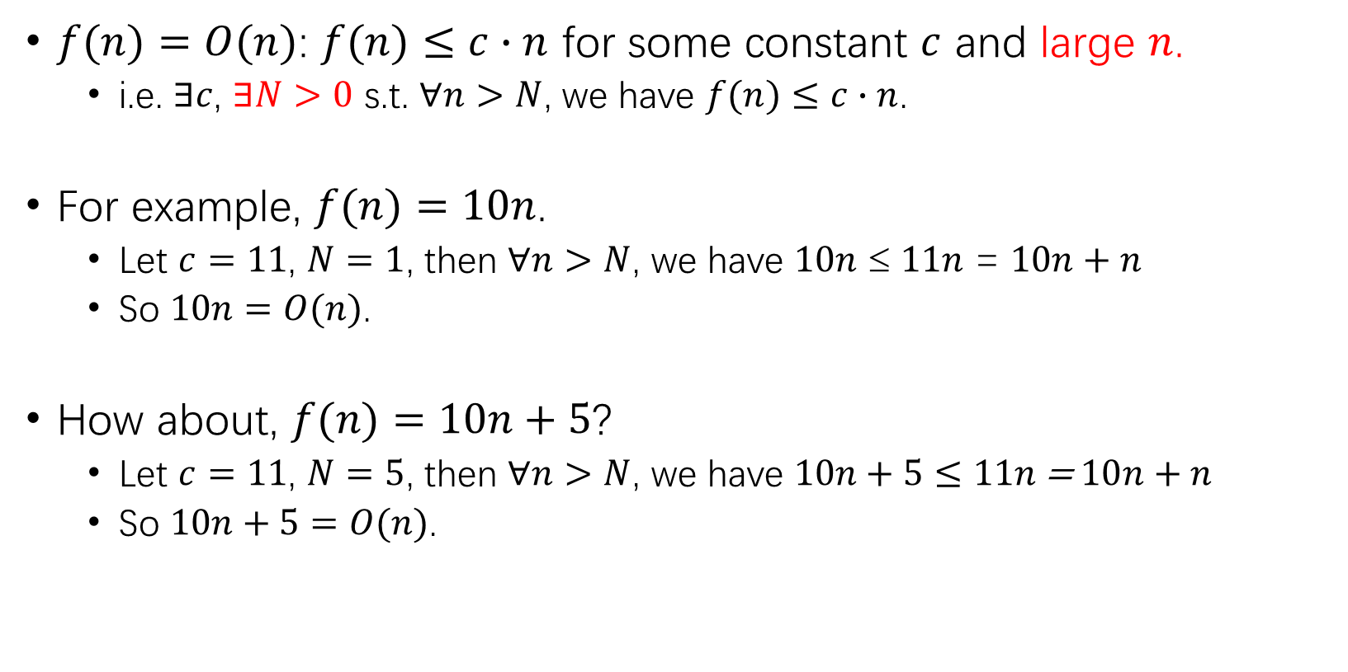
Extended definition: O
$f(n)=O(n)$: $f(n)≤c∙n$ for some constant $c$ and large $n$.
i.e. $∃c$, $∃N>0$ s.t. $∀n>N$, we have $f(n)≤c∙n$.
For example, $f(n)=10n$.
Let $c=11$, $N=1$, then $∀n>N$, we have $10n$ ≤ $11n$ = $10n+n$
So $10n=O(n)$.
How about, $f(n)=10n+5$?
Let $c=11$, $N=5$, then $∀n>N$, we have $10n+5≤11n\text{ = }10n+n$
So $10n+5=O(n)$.

Slide 20
Example: n^{1/2} vs. n
10n
9n
7n
n^{1/2}
0.1n
No matter how small c is, as long as it’s some positive constant, then finally cn will catch up n^{1/2}.
Thus, n^{1/2} = O(n)

Slide 21
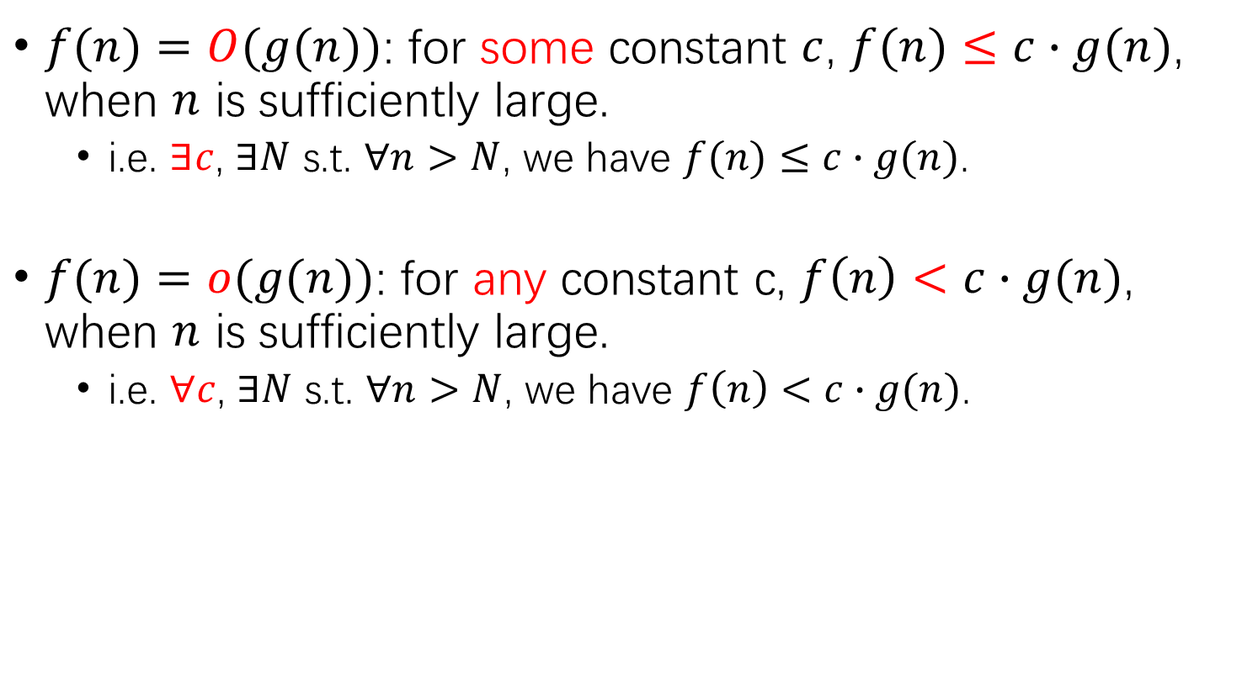
General definitions
$f(n)=O(g(n))$: for some constant $c$, $f(n)≤c∙g(n)$, when $n$ is sufficiently large.
i.e. $∃c$, $∃N$ s.t. $∀n>N$, we have $f(n)≤c∙g(n)$.
$f(n)=o(g(n))$: for any constant c, $f\left(n\right)<c∙g(n)$, when $n$ is sufficiently large.
i.e. $∀c$, $∃N$ s.t. $∀n>N$, we have $f\left(n\right)<c∙g(n)$.

Slide 22
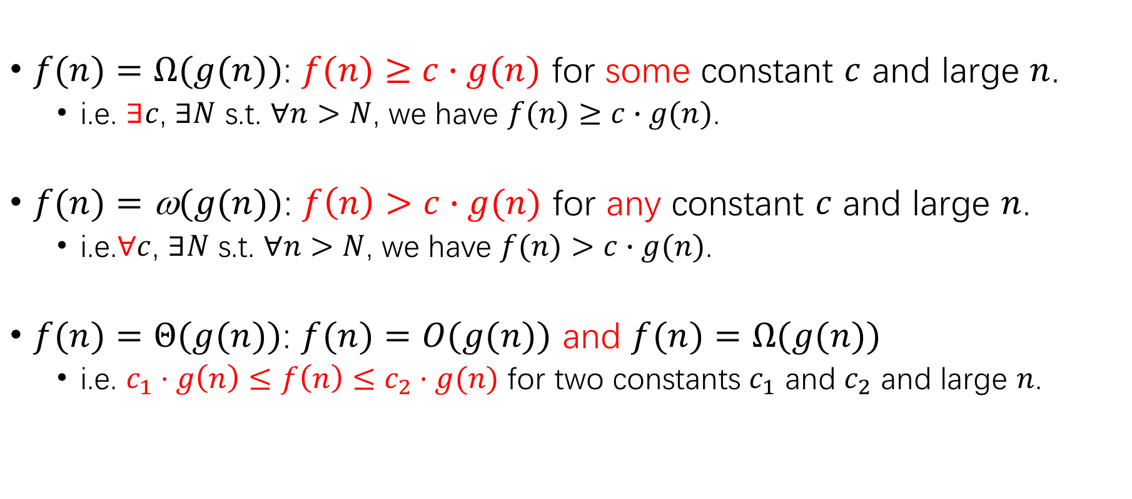
General definition (cont.)
$f(n)=Ω(g(n))$: $f(n)≥c∙g(n)$ for some constant $c$ and large $n$.
i.e. $∃c$, $∃N$ s.t. $∀n>N$, we have $f(n)≥c∙g(n)$.
$f(n)=\text{ω}(g(n))$: $f\left(n\right)>c∙g(n)$ for any constant $c$ and large $n$.
i.e.∀$c$, $∃N$ s.t. $∀n>N$, we have $f(n)>c∙g(n)$.
$f(n)=Θ(g(n))$: $f(n)=O(g(n))$ and $f(n)=Ω(g(n))$
i.e. $c_{1}⋅g\left(n\right)≤f\left(n\right)≤c_{2}⋅g(n)$ for two constants $c_{1}$ and $c_{2}$ and large $n$.

Slide 23
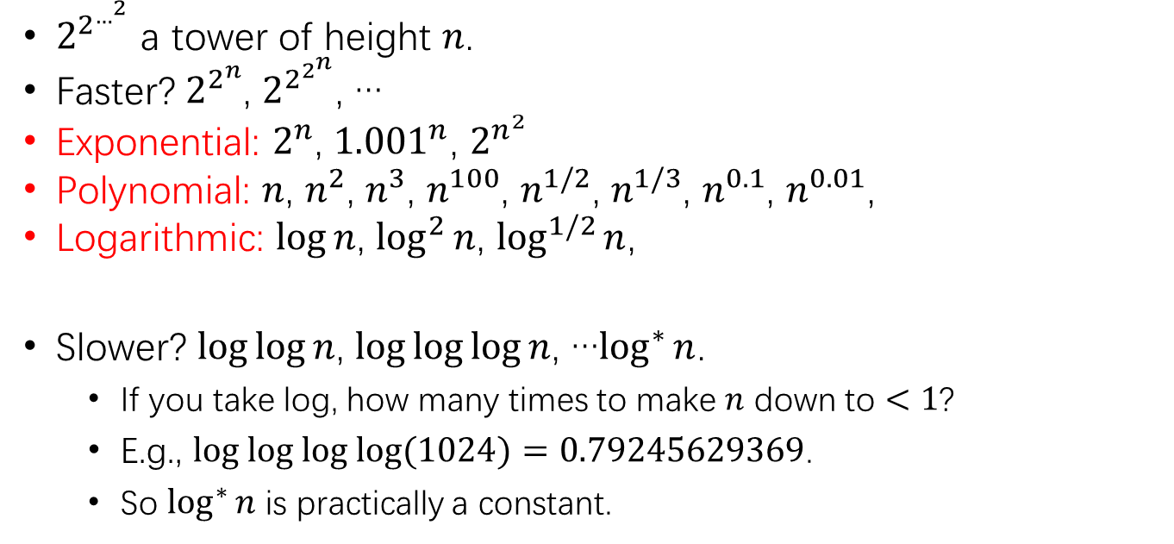

Spectrum of functions
|←exponential→|
tower
O(1) , …, log* n, … loglog n, … log n, log² n, …
… n^{1/3}, n^{1/2}, n, n², n³, … … 2^{n}, $2^{n^{2}}$, … $2^{2^{n}}$, … $2^{2^{…^{2}}}$
…
|← constant →|
|← logarithmic →|
|← polynomial →|
double exponential
$2^{2^{…^{2}}}$ a tower of height $n$.
Faster? $2^{2^{n}}$, $2^{2^{2^{n}}}$, …
Exponential: $2^{n}$, ${1.001}^{n}$, $2^{n^{2}}$
Polynomial: $n$, $n^{2}$, $n^{3}$, $n^{100}$, $n^{1/2}$, $n^{1/3}$, $n^{0.1}$, $n^{0.01}$,
Logarithmic: $\log{n}$, $\log^{2}{n}$, $\log^{1/2}{n}$,
Slower? $\log{\log{n}}$, $\log{\log{\log{n}}}$, …$\log^{∗}{n}$.
If you take log, how many times to make $n$ down to $<1$?
E.g., $log log log log{(1024)}=0.79245629369$.
So $\log^{∗}{n}$ is practically a constant.
Notes:
Log*: iterated logarithm

Slide 24
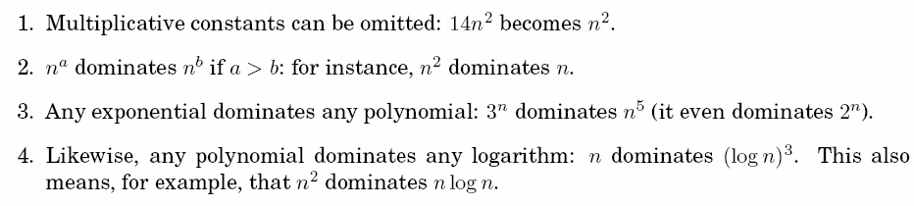
Commonsense rules

Slide 25
Properties of asymptotic notations
(1) Transitivity:
f(n)= Θ(g(n))， g(n)= Θ(h(n)) ⇒ f(n)= Θ(h(n))；
f(n)= O(g(n))， g(n)= O (h(n)) ⇒ f(n)= O(h(n))；
f(n)= Ω(g(n))， g(n)= Ω(h(n)) ⇒ f(n)= Ω(h(n))；
f(n)= o(g(n))， g(n)= o(h(n)) ⇒ f(n)= o(h(n))；
f(n)= ω(g(n))， g(n)= ω(h(n)) ⇒ f(n)= ω(h(n))；

Slide 26
(2) Reflexivity
f(n)= Θ(f(n))
f(n)= O(f(n))
f(n)= Ω(f(n))
(3) Symmetry
f(n)= Θ(g(n)) ⇔ g(n)= Θ (f(n))
(4) Mutual symmetry
f(n)= O(g(n)) ⇔ g(n)= Ω (f(n))
f(n)= o(g(n)) ⇔ g(n)= ω (f(n))
(5) Arithmetic operations：
O(f(n))+O(g(n)) = O(max{f(n),g(n)})
O(f(n))+O(g(n)) = O(f(n)+g(n))
O(f(n))*O(g(n)) = O(f(n)*g(n))
O(cf(n)) = O(f(n))
g(n)= O(f(n)) ⇒
O(f(n))+O(g(n)) = O(f(n))+O(O(f(n))) = O(f(n))
Notes:
Symmetry[ˈsɪmətri]
Mutual[ˈmjuːtʃuəl]

Slide 27
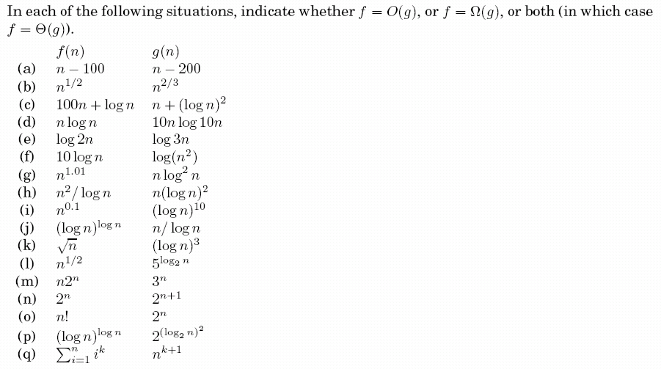
Exercise 0.1
solution ideas:
commonsense rules;
division/alignment;
definition.

Slide 29
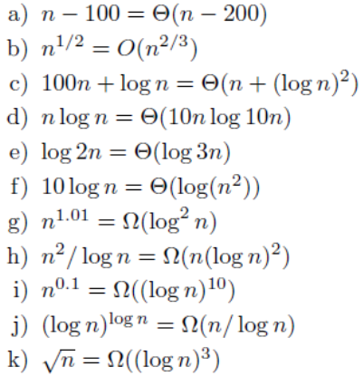
Notes:
logn*loglogn=logy=logn^loglogn, y=n^loglogn

Slide 30
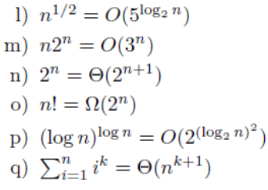

Slide 32

Notes:
1=(k+1,k+1)*j^0

Slide 33
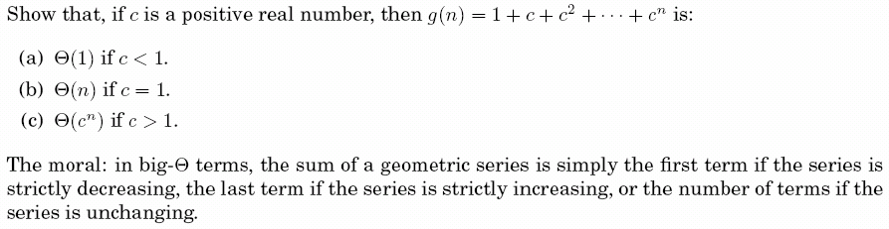
Exercise 0.2
Notes:
分子numerator
分母denominator

